Slide 1
Roman History
Roman History is divided up into 3 periods – Monarchy
- Republic
- Empire
Each period’s title comes from the form of government used at the time.
The Romans are most known for their military achievements, architectural mastery and influence in language and Western culture

Slide 2
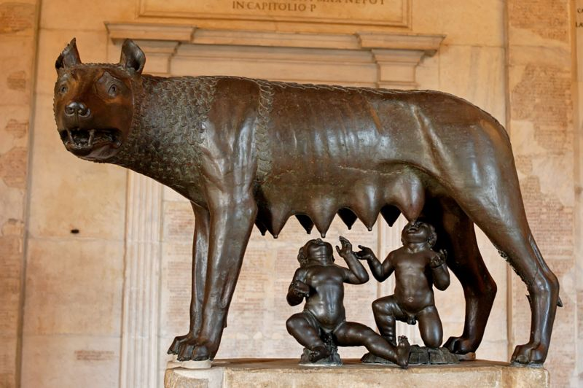
The Monarchy
Dates from 753 BC – 509 BC
There were 7 kings – Romulus was the first
Legendary founding story – Romulus and Remus – raised by a she-wolf
Romulus wins out – city called Rome after himself – not many people there – needed to increase population
Invites “undesirables” in
Eventual conquering of
surrounding areas

Slide 3

Monarchy continued
Romulus creates Campus Martius for the training of soldiers – in honor of his father
Has lictors who guard him – they carry the “fascēs” which was a symbol of power
Eventually the Etruscans assimilate
Other kings: 2nd – Numa Pompilius – set up religion
3rd – Tullius Hostilius – destroyed Alba Longa
4th – Ancus Martius – built a bridge over Tiber
5th – Tarquinius Priscus – set up Forum
6th – Servius Tullius – set up city wall; political assembly for voting
7th king - Tarquinius Superbus is overthrown because of his tyranny – he did set up a sewer system and many public buildings but his overall nasty disposition and desire for absolute power did not sit well with certain citizens

Slide 4
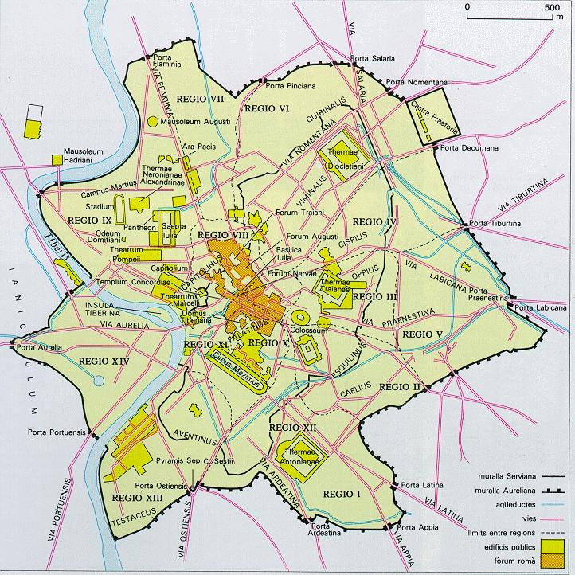
7 Hills
Palatine
Capitoline
Aventine
Esquiline
Viminal
Caelian
Quirinal

Slide 5
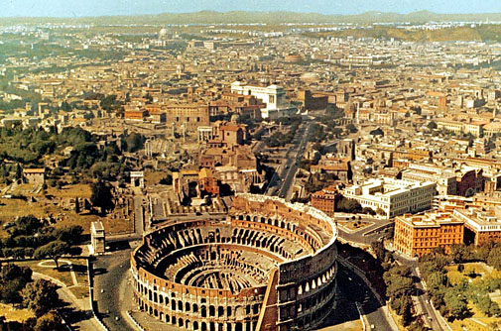

Slide 6
End of the Monarchy – Start of the Republic
Tarquinius Superbus is overthrown – revolt is led by Brutus – he becomes first consul
The Republic – 509 BC – 27BC
A time of conquest – gathering territory and expanding population, especially in Italy
Many wars – foreign enemies - mainly Carthage
From 100 BC – 27 BC – 3 civil wars take place

Slide 7
Carthage & the Punic Wars
1st Punic War – 264 BC – 241 BC
over the island of Siciliy – both wanted it for trade purposes
Various battles took place over a 20-year period – eventually Rome prevailed and imposed harsh sanctions
Carthaginians were not allowed to have a navy, could only have an army to defend their immediate borders, had to give money to the Romans, and were not allowed to trade with other nations.

Slide 8
The Punic Wars (cont)
2nd Punic War – 218 BC – 201 BC
Hannibal, a Carthaginian general, grew up hating the Romans because of the sanctions
He led a campaign against the Romans that was almost successful – after defeating the Roman army numerous times, he was finally defeated by Scipio, who received the title “Africanus” for his victory over the Carthaginians.
Even more harsh sanctions were put in place after this war. Carthage was quiet until 149 BC.

Slide 9
The Punic Wars (last one)
3rd Punic War – 149 BC – 146 BC
Carthage tried to defend the city against an outside foe and they started up their army again – a major violation of the sanctions
The Romans crushed the city and left nothing behind – those who weren’t killed were enslaved and the city was plowed under

Slide 10
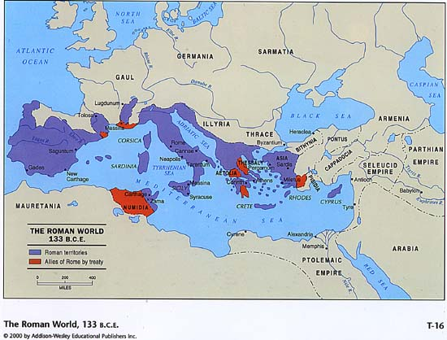

Slide 11
Other people in the Republic
Cato the Elder – prominent just before the 3rd Punic War – always ended speeches with “Carthago delenda est”; never got to see the city destroyed
Cicero – a prominent senator, speech maker and writer – his letters give us a day by day account of what happened in Rome at its most turbulent time - he’ll be important during Latin III

Slide 12
Civil Wars
1st Civil War – between Marius and Sulla – Marius was a general and Sulla under his command negotiated a surrender but Marius took the credit – bad blood
In 88 BC, Sulla was consul and Marius was given command of the army – Sulla was upset – war starts. Marius dies and Sulla defeats the rest of his army a few years later

Slide 13
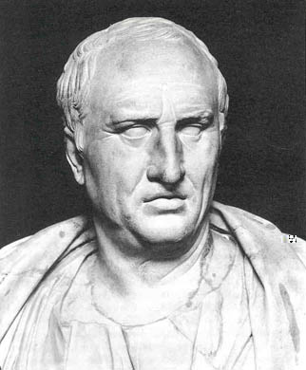
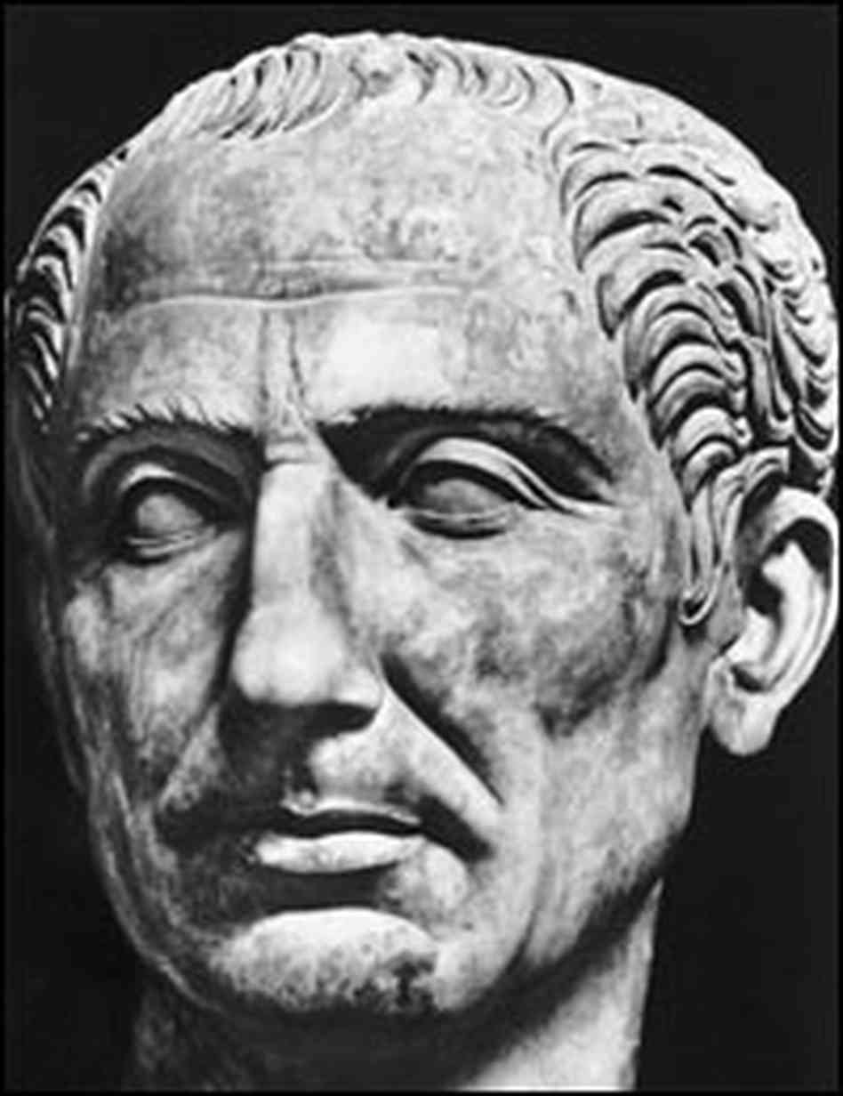
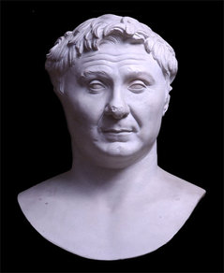
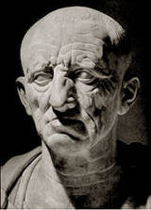
Caesar
Cicero
Pompey
Cato the Elder

Slide 14
Civil Wars (cont)
In 60 BC, Caesar, Pompey and Crassus form the 1st Triumvirate – they are all powerful men –
2nd Civil War – 49BC -48 BC between Julius Caesar and Pompey the Great –
Caesar conquered vast amounts of territory in Gaul from 58 BC – 50 BC and wanted to run for the consulship in 49 – Pompey convinced the senate not to let him run –
Caesar gets angry and crosses the Rubicon River with his army, committing treason – he says, “The die is cast” (Alea iacta est)
He defeats Pompey’s forces at the Battle of Pharsalus in 48 BC – Pompey flees to Egypt and his beheaded there by an ally of Caesar’s.

Slide 15
Caesar
With Pompey out of the way, Caesar goes to Rome and becomes consul in 46
In 45, he is made dictator for a period of 6 months to squelch an uprising; he does so and then declares himself “dictator for life”
A group of senators are uncomfortable with Caesar trying to gain so much power
They conspire to kill him and he is assassinated on the Ides of March (March 15th ) in 44 BC
In his will, he adopts his grand-nephew, Octavian, as his heir

Slide 16
Rise of Octavian
Octavian comes to Rome to claim his inheritance – “a mere boy, owing everything to a name” – the name gave him some power and followers
He was only 19 years old – demands to be elected consul and wants to avenge his father’s death
Brutus and Cassius, the main conspirators, leave Rome – fearing unpopularity
Octavian allies himself with Marcus Antonius – an already established general and leader
They join up with Lepidus to form the 2nd Triumvirate
Antonius and Octavian defeat the forces of Brutus and Cassius at the Battle of Philippi in 42 BC

Slide 17
Rise of Octavian (cont)
Both Antonius and Octavian gain popularity and tension ensues – Treaty of Brundisium - 40 BC
Antonius tries to set up Octavian by making him settle all the soldiers – a difficult task
Eventually there is a split – Antonius goes to the East to get riches and gain power – meets Cleopatra and they unite against Octavian
Octavian creates propaganda that Antonius has become a traitor – gains support
Defeats the forces of Antonius and Cleopatra at Battle of Actium in 31 BC

Slide 18
Octavian becomes Augustus
In 27 BC – Senate gives him the title “Augustus” – “revered”
Under his 40 year reign, Rome enjoys a time of peace and prosperity – the arts and writing flourish – buildings are restored – new laws are established
It is called the Pax Romana
He rules from 27 BC until his death in 14 AD
His stepson, Tiberius, becomes second emperor

Slide 19
Other emperors
Julio-Claudian Family –
Caligula – tries to make horse a senator
Claudius – conquers Britain
Nero – most known for letting part of city burn down during a fire
Flavian Dynasty – build the Colosseum in 80 AD
Antonine Dynasty – Marcus Aurelius, Trajan and Hadrian are major emperors
The Emperor Constantine changes religion to Christianity in the early 300s AD and moves the capital to Constantinople, which seriously weakens the western empire
Empire falls in 476 AD with the sack of the city of Rome by the Goths, Visigoths and Vandals from Northern Europe

Slide 20
